Slide 1
Accounting Web Update
CodeZone 2011-May-08

Slide 2
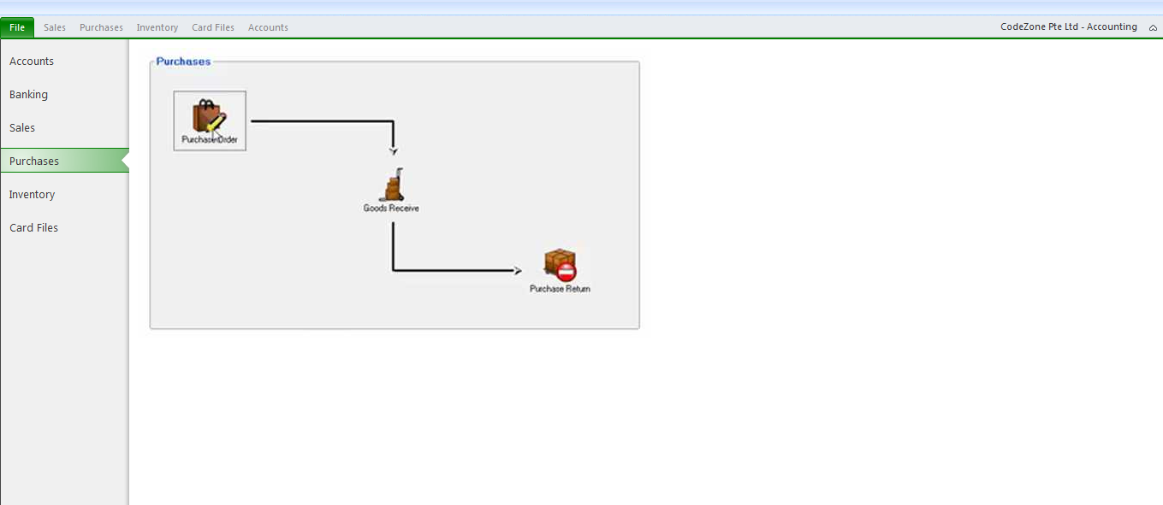
Manu Page

Slide 3
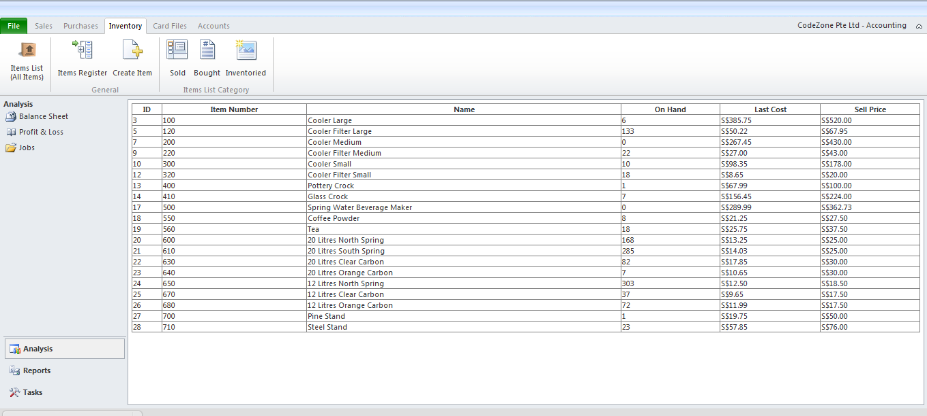
Inventory Web Page

Slide 4
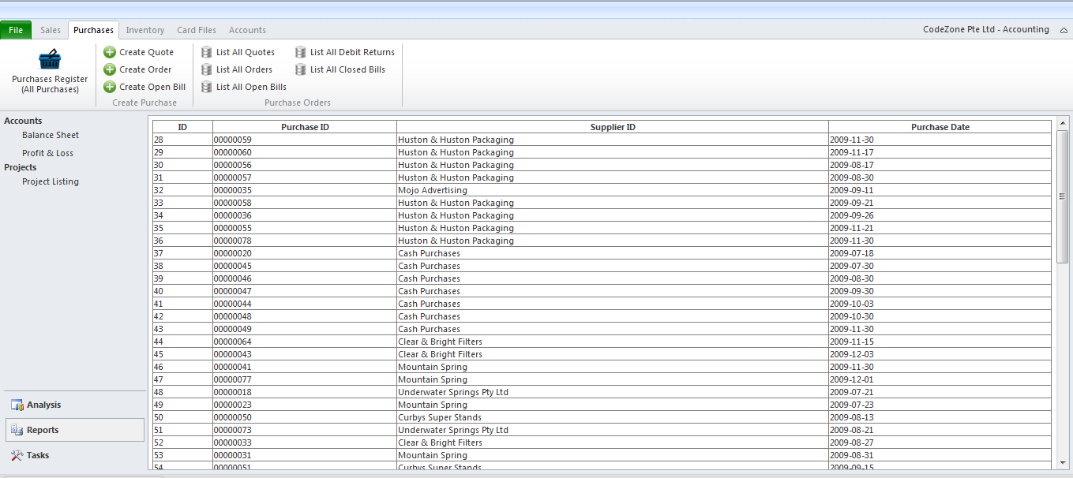
Purchase Web Page

Slide 5
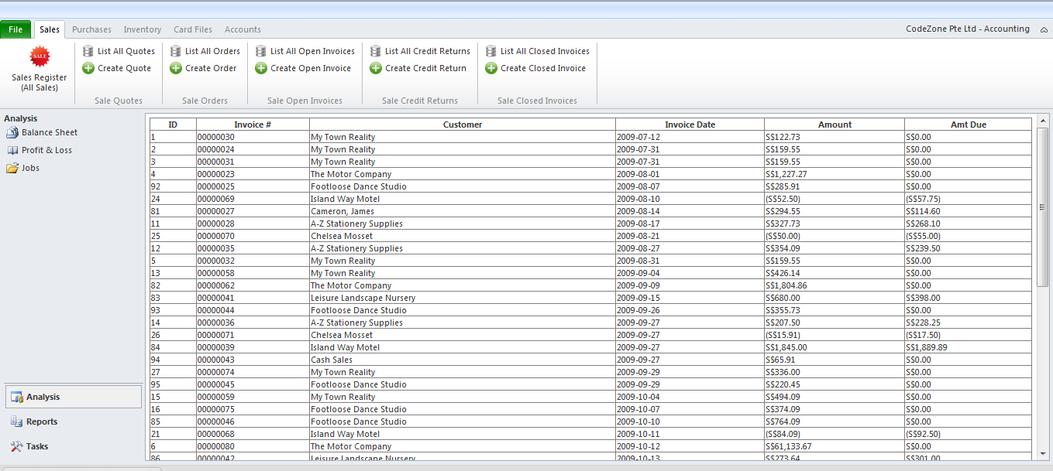
Sales Web Page

Slide 6
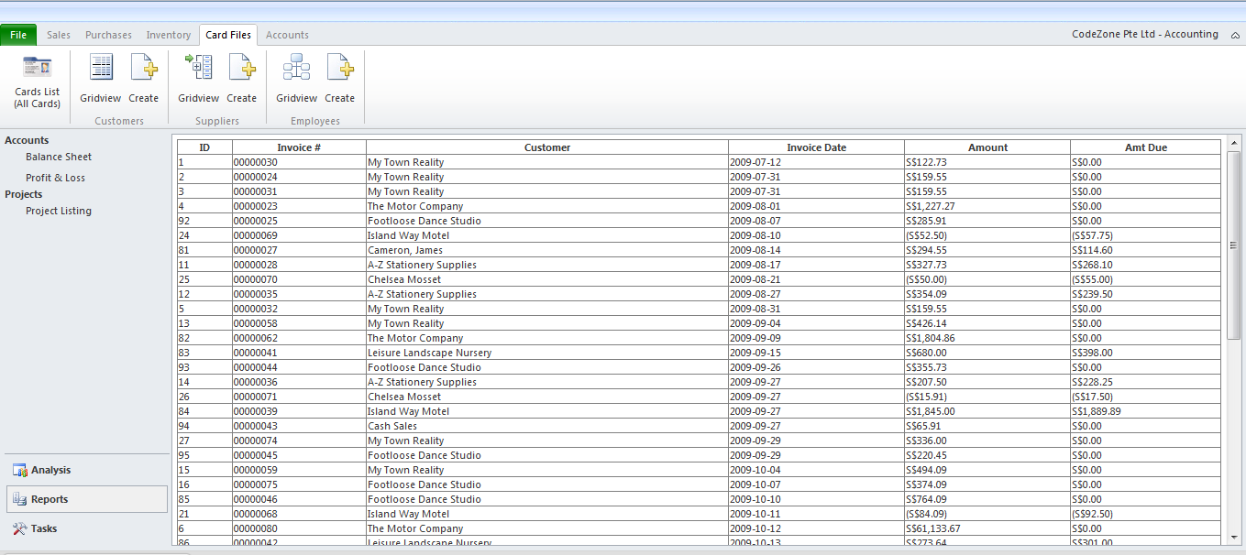
Card Files Web Page

Slide 7
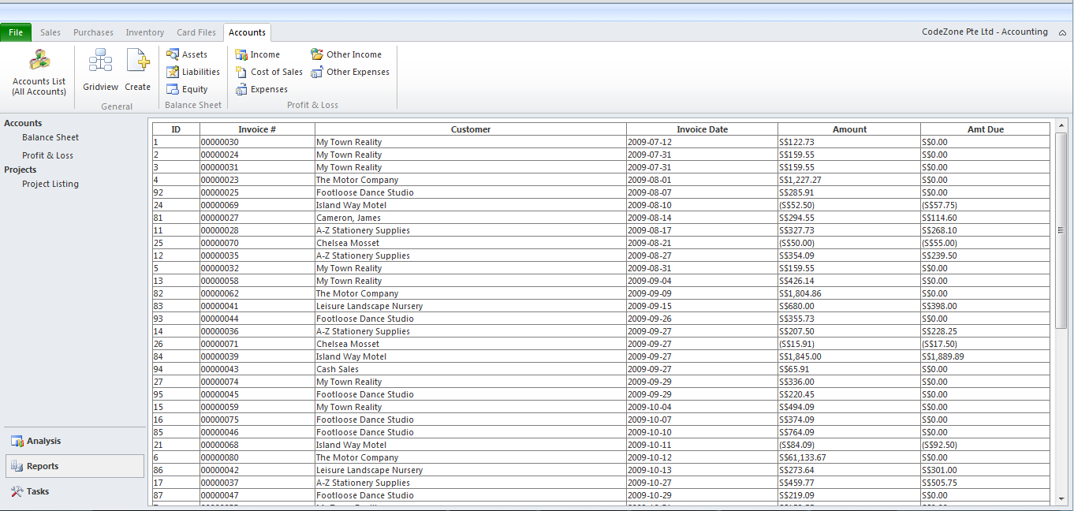
Accounts Web Page

